Slide 1
Here’s the list of tools I promised:
  Tableau
  Tableau Public – free and public version
  R
  Python
  D3
  Google Fusion
  Gephi
  Processing
  Fineo
  Platfora – Hadoop only
  Spotfire
  list of tools from DataVisualization.ch

Slide 2
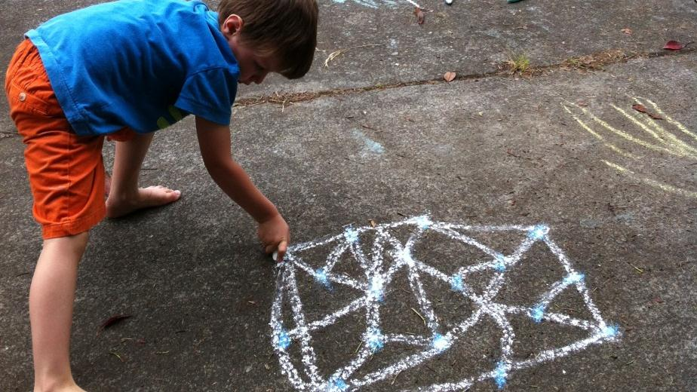
How to See Data
Kim Rees, Periscopic
@periscopic, @krees
Notes:
This is my “secret sauce” talk. I’ve never done this talk before. About 2 years ago we hired our first data scientist, mostly to replace me because I mostly hang out at Stratas... So I plunked him down at a desk and gave him a bunch of data. Well, then I quickly realized that even if you’re data minded, you still need guidance to make the leap to visuals... It’s a CREATIVE PROCESS.
So, this session is about that. It’s spawned from my discussions with our data scientist. It covers techniques for reframing our thoughts about data, how to describe data, and coming up with visual solutions.

Slide 3

Notes:
Some of you in here may not remember this bad boy. But I tell you what, if you’re friend had a 909-7880 number... Well, they weren’t your friend anymore... That’s too much work! For those of us who work directly with data, we see... (next)

Slide 4
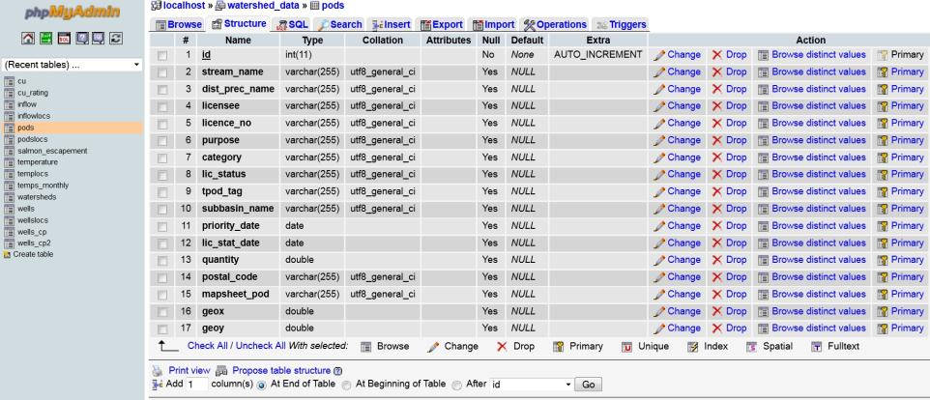
Notes:
Something like this... Okay? That’s awful.

Slide 5
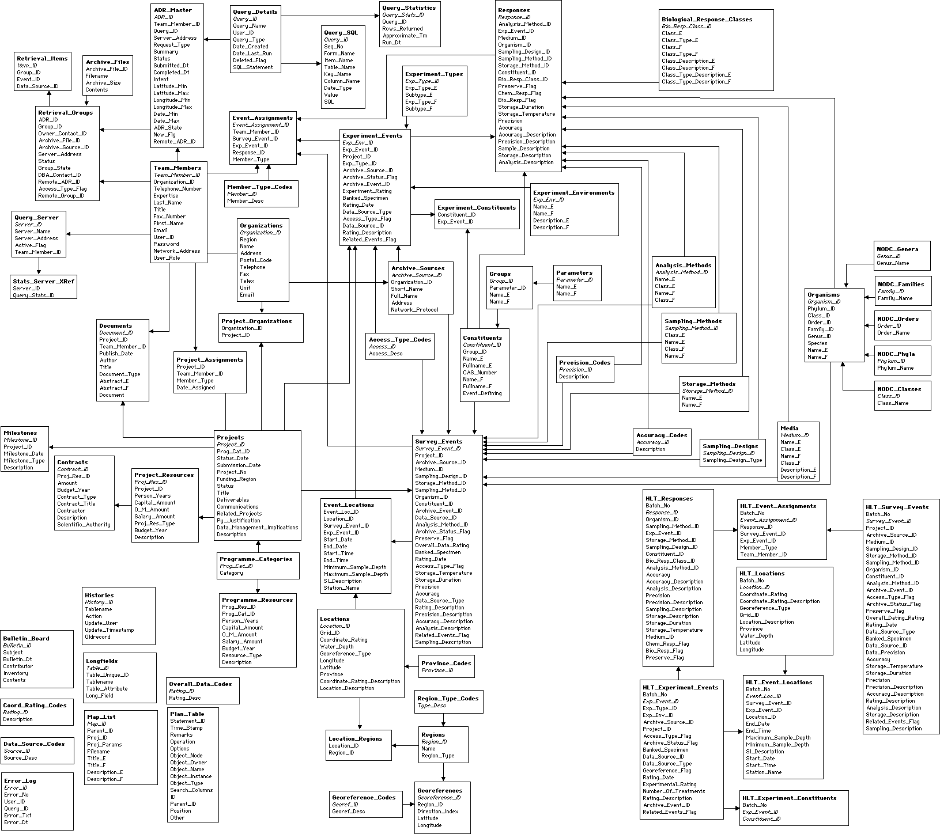
Notes:
And yes, we have nice diagrams like this. (ER diagram)
And this is the way we’ve learned to “see” data. In tables. In rows. In diagrams. In cryptic ways.

Slide 6

=
Notes:
I’d say it equals this. Far removed from what we’re actually *doing*.

Slide 7
Data at First Sight
Notes:
So how do we wrap our heads around what data ACTUALLY looks like? How do we make that transition?

Slide 8
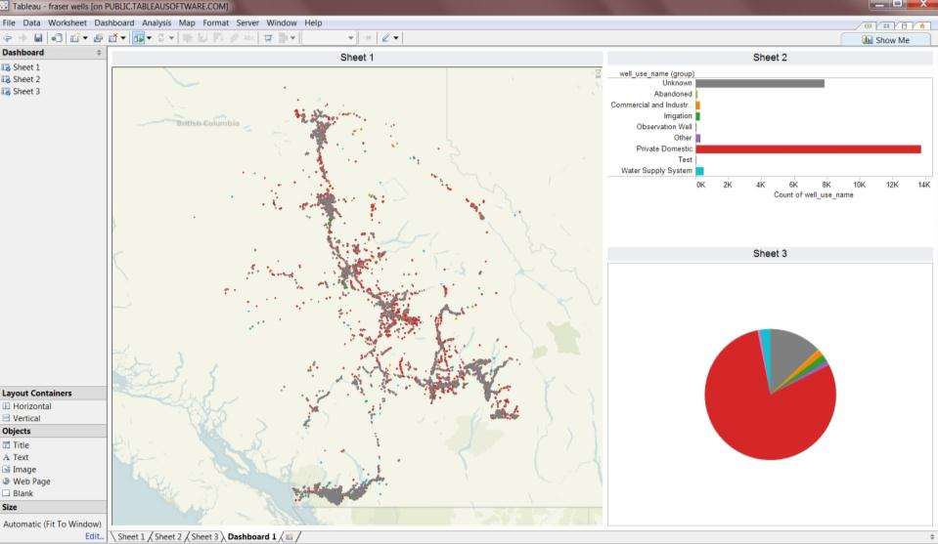
Notes:
The first step is obvious... Choose a tool and throw your data into it. I prefer Tableau because it’s quick and dirty... I don’t program much anymore, so this keeps me from getting stymied by syntax. It’s pretty flexible and usually gives me some quick insights. It lets me see the SHAPE of the data.

Slide 9
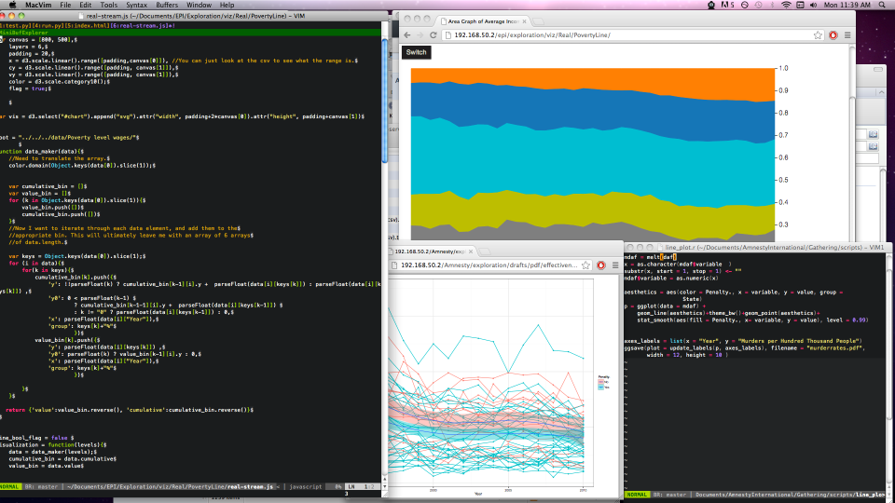
Notes:
Our Data Scientist, Andrew, also likes R, Python, and D3. You get the richness of Tableau, but also the flexibility of programming custom stuff into your visualizations including motion. Then there are always specialized tools such as Gephi, Processing, etc, .... For networks and other specialized datasets.
I’m not going to spend any time on these tools because you’re all smart people. You can download them and figure them out if you haven’t done so already.

Slide 10
Unthinking Data
Notes:
So I usually spend about a day just tossing things about in Tableau, and there’s a point where you get a little overwhelmed. You should take a step back. You’ve been heads down in the weeds of data for awhile, so you’ll need to get a new perspective on it.
So, using one of those tools I just mentioned, you can leave the room right now and do pretty well by making charts and graphs. But if you want to do cool viz stuff... You need to do all the rest of the stuff I’m going to talk about. This is where the magic and the hard work happens. It’s unthinking yourself out of those weeds of data.

Slide 11
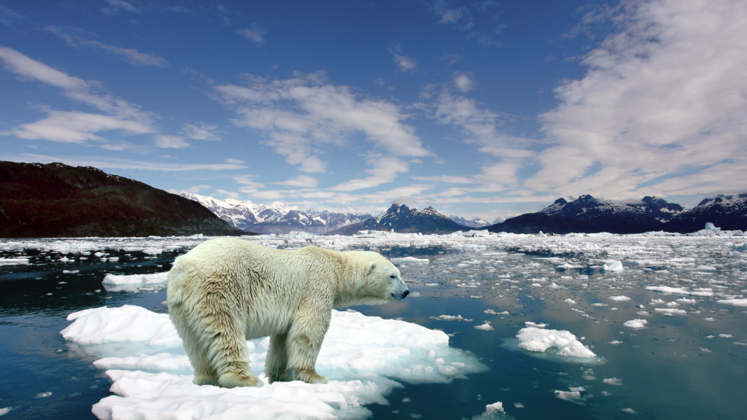
Notes:
So, here we go, put away the database. Look at the actual THING you’re dealing with. Is it polar bear data? Look at photos of polar bears, the arctic, maps...

Slide 12
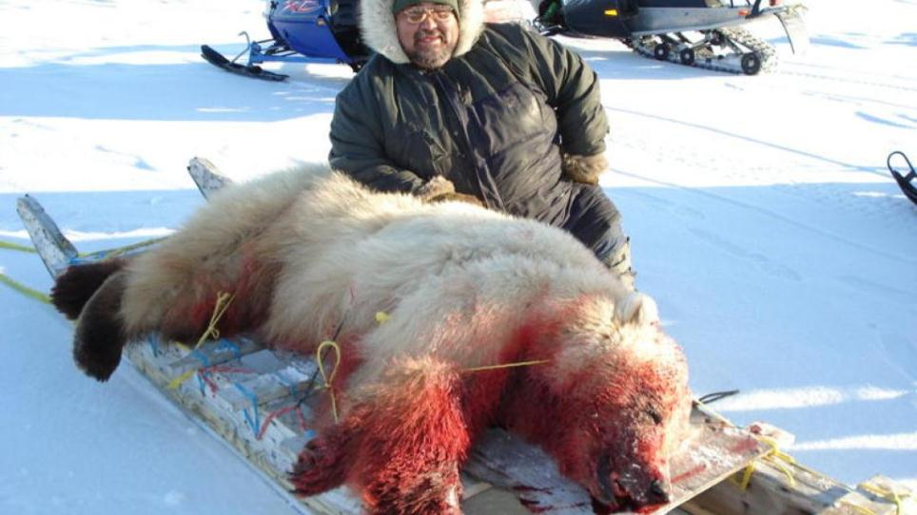
Notes:
Whatever it is that constitutes that data. You may find unexpected or even shocking things. There was a datapoint in our polar bear data called “harvest.” I didn’t know what that meant. Well, it turns our that indigenous people can still legally kill this endangered animal. It’s both heartbreaking and beautiful.... A traditional way of life slamming up against a modern day reality.
When you see it in a photograph it can put a real face on that sterile number in a column of a spreadsheet.

Slide 13
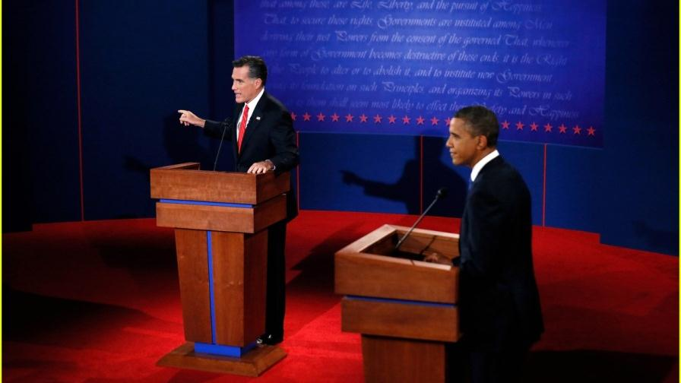
Notes:
If you can, go to the thing you’re dealing with. Is it a debate? Go watch and hear an actual debate. What do you see or notice that’s outside the range of your data... Or what about your data stands out?

Slide 14
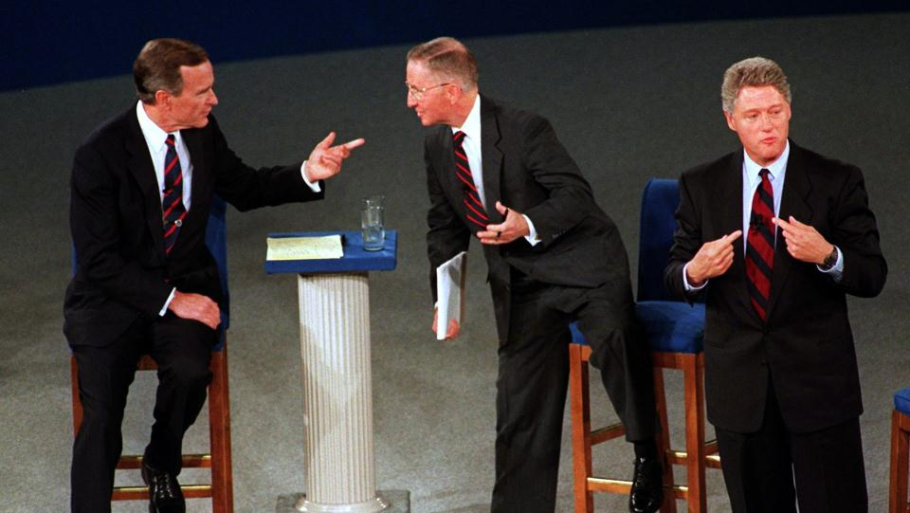
Notes:
Look at these guys! Jeez... There’s a lot going on there.. Who’s talking to whom... Hand gestures.... Disrespect... Avoiding the question... So forth. That’s probably not in your Excel file.

Slide 15
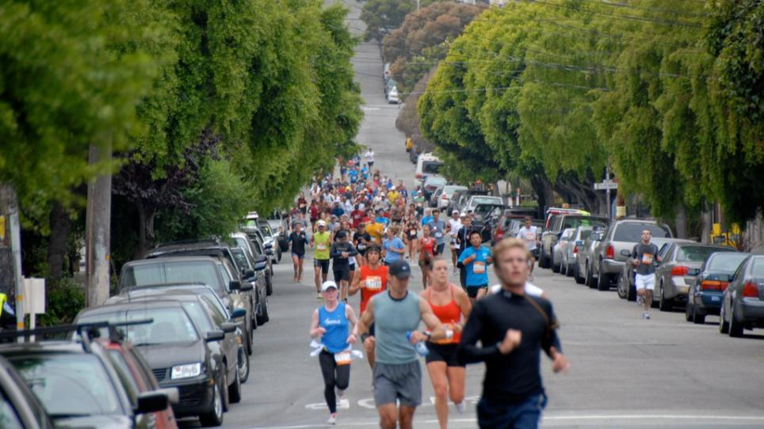
EXERCISE 1:
what are the datapoints here?
Notes:
Exercise:
Look at foot race data. Take a minute and note 5 things about a race. Mine were:
1) finish times (obvious)
2) Time between finish
3) Pace of runners
4) Biometrics (stride, heart rate, etc.)
5) Ambient (wind, temp, etc.)
6) Type of shoe, brand, etc.
7) What they ate in the last 24 hours

Slide 16
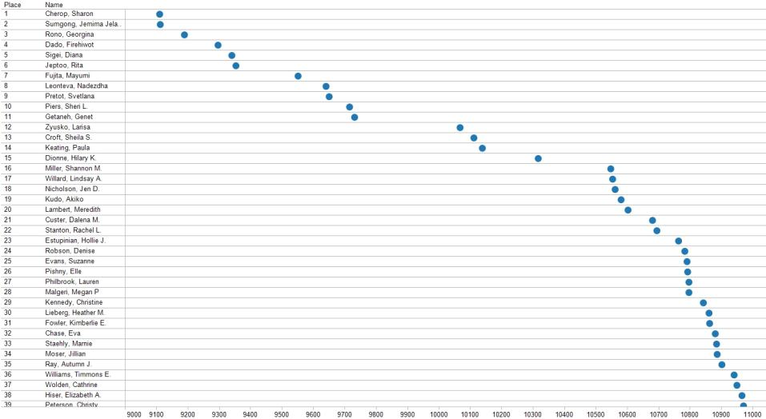
Notes:
Example visualizations of those.... (in Tableau these are simply the finish times)

Slide 17
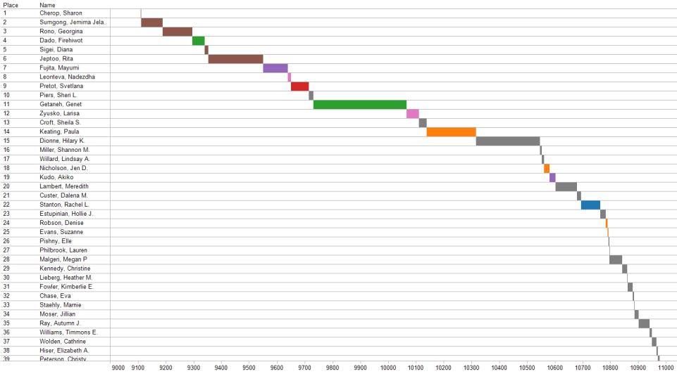
Notes:
These are the times between finish times and also colored by country.
I don’t know if you can tell what I’m doing here, but these are in Tableau... My mode of working is to use the “duplicate sheet” feature... So I just throw some data on the screen, then I say ok, that’s sort of interesting, but what if I compare it to X. So I do “duplicate sheet” and throw variable X into the mix. I keep doing this just as a way of exploring. That way I can always go back to something a few variables back in case I send myself down a rabbit hole.
It’s like a weird source control for Tableau.

Slide 18
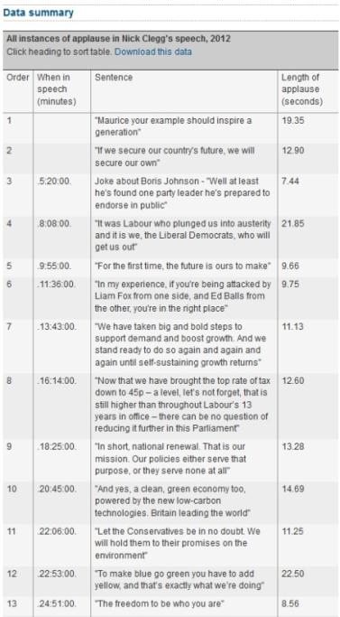
Notes:
It’s not only the data you have in front of you. What other observations can you make about the subject? For instance, The Guardian took a unique approach to speeches. You could look at length, topics, words... But they looked at the amount of applause. What a great simple way to look at sentiment. They didn’t need to do any fancy NLP or crowdsourcing.

Slide 19
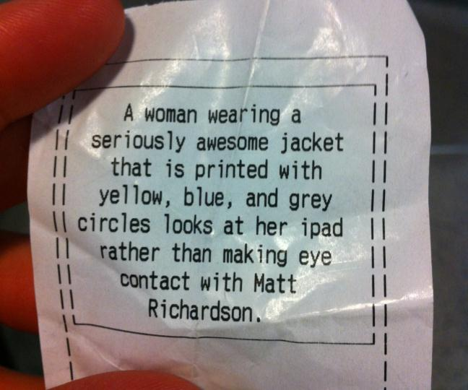
Notes:
Here’s a great example of rethinking the data. This is a great project by @mattrichardson who’s in ITP at NYU. In this case the data is a still picture taken with a camera. However, the output (or “visualization”) is actually text. (That’s a “picture” of me!) Here, a textual representation of the scene adds a certain richness to it.

Slide 20
why? why? why? why? why? why? why? why? why? why? why? why?
why? why? why? why? why? why?
why? why? why? why? why? why?
why? why? why? why? why? why?
why? why? why? why? why? why? why? why? why? why? why? why?
why? why? why? why? why? why?
Notes:
Another tactic I like to use is to pretend I’m explaining the topic to a 5-year-old. Or really explain it to my real life 5 year old. Or to your parents... Whomever you think wouldn’t understand it without pictures.
With a 5-year-old, every explanation leads to another “why?” So keep explaining until your “whys” run out.

Slide 21
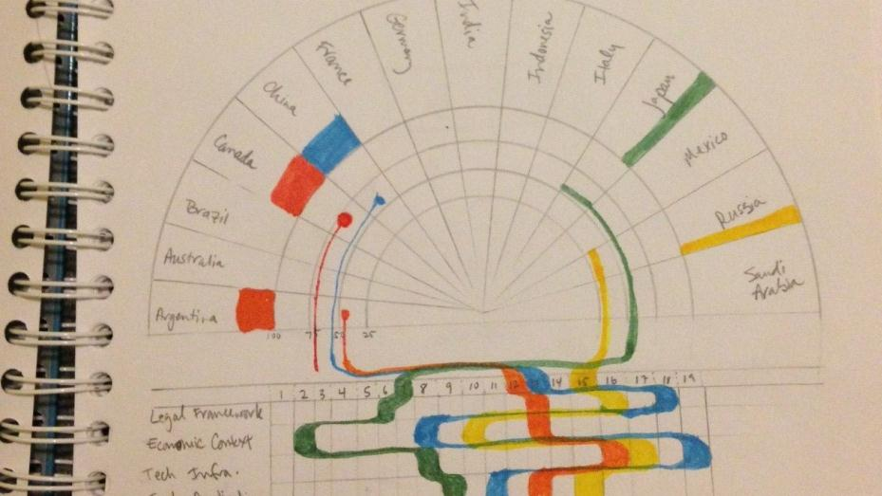
Notes:
This is a sketch for a project with did with the Economist Intelligence Unit. It’s a cyber-security index, and countries get ranked and scored.
It’s not the first sketch... It shows where countries rank on the spectrum, and also how they are scoring against the various indicators. Okay, but why do the ranks follow those streams. So a subsequent sketch shows that the width of the stream equates to their score. And it keeps going.... There were many sketches of this before it went to design.

Slide 22
Living, Breathing Data
Notes:
Most data is living, breathing data, meaning, it has a real world life. It’s salmon that are dying at sea, kids being bullied, people without enough money to feed their families. You need to confront the emotion of data.

Slide 23
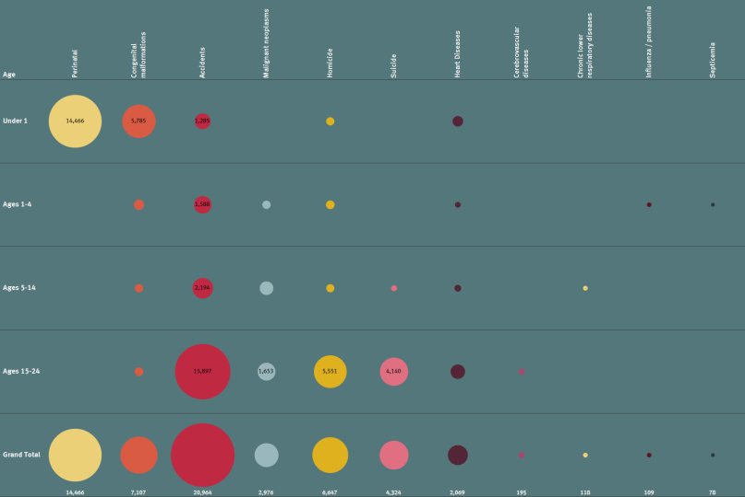
Notes:
Are there strong and weak relationships? Is there heavy data and light data? Here is a small graphic about pediatric deaths. Wait, that sounds rather clinical.... Actually, these are kids who are dying. Here they are represented as a bubble chart. But wait, bubbles? Okay, that says “kids” but more along the lines of “fun kids.” It doesn’t really say “dead kids.” Describing things in non-flowery words can really help get to the emotion of the data.

Slide 24
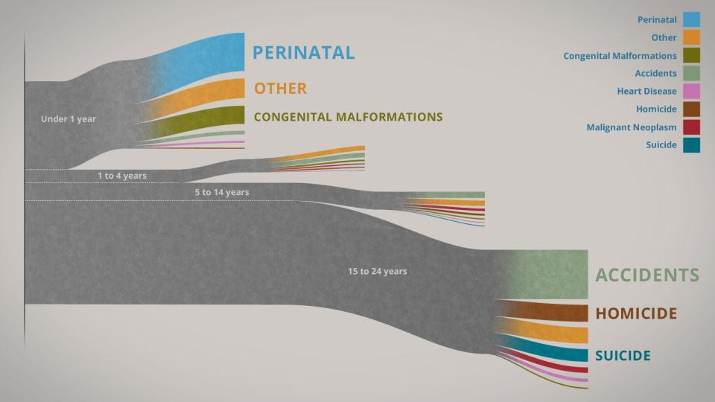
Notes:
Here’s something more appropriate. This shows a bit of the emotion of this data.... These are paths. And at the end of each path, those kids are no longer with us. So, when we look at this, we don’t lose sight of the message. My oldest son was on this top path, but then his doctors cured him of cancer. I can actually see him as a datapoint along a pathway. Much different than seeing him as part of a bubble.

Slide 25
Datasculpting
Notes:
Okay, so then you get to a point where you feel like.... Well, a little overwhelmed by all this amorphous emotion and all these qualitative things.... Everything starts to feel a bit mushy.
That’s when I go back to the data. This is the dance you do with data.... It’s like sculpting... Just as with any other medium, you have to respond to the qualities of your data, to let it go in its own direction... Then have the ability to coax it back to elegance.... To cull its significance.

Slide 26
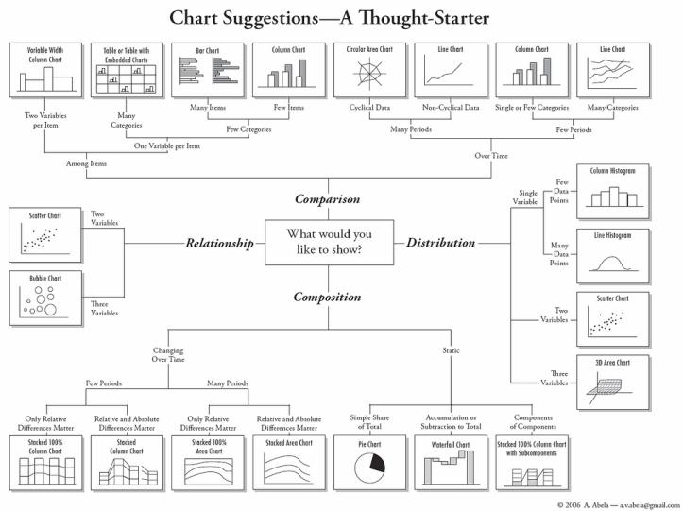
Notes:
http://extremepresentation.typepad.com/files/choosing-a-good-chart-09.pdf
This is cheesy, but I’m not afraid to admit that I use this. I used it a lot more when I first started doing visualization, but I still turn to it when I just need some clarity. It basically starts in the center with the type of thing you’re trying to show – comparison, relationship, distribution, etc. – then shows a decision tree for each of those things to get to the right chart. Now it’s terribly limited, but it’s a simple place to start when you’re feeling overwhelmed and just need a starting point.

Slide 27
Relationships
Notes:
There are several things you can look for in the data. Relationships are a great place to start because we can see them at a high level... These can be things like A owns B. A is a parent of B. A is a friend of B. Those sorts of things. This is a good time to go back to your ER diagram if you have one (or make one if you haven’t).

Slide 28
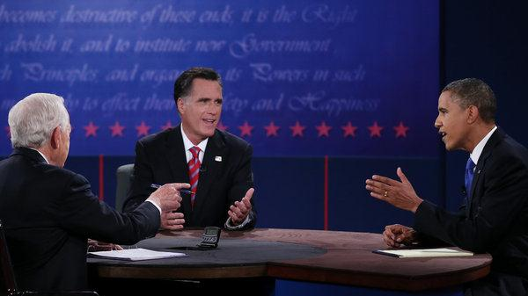
EXERCISE 2:
what are the relationships?
Notes:
Okay, so let’s get back to debates. What are some of the relationships in a debate? I’ll give you a moment.....
candidate speaks words.
A candidate also speaks about topics.
A candidate has a cadence.
Words belong to a topic.
The moderator drives the topics

Slide 29
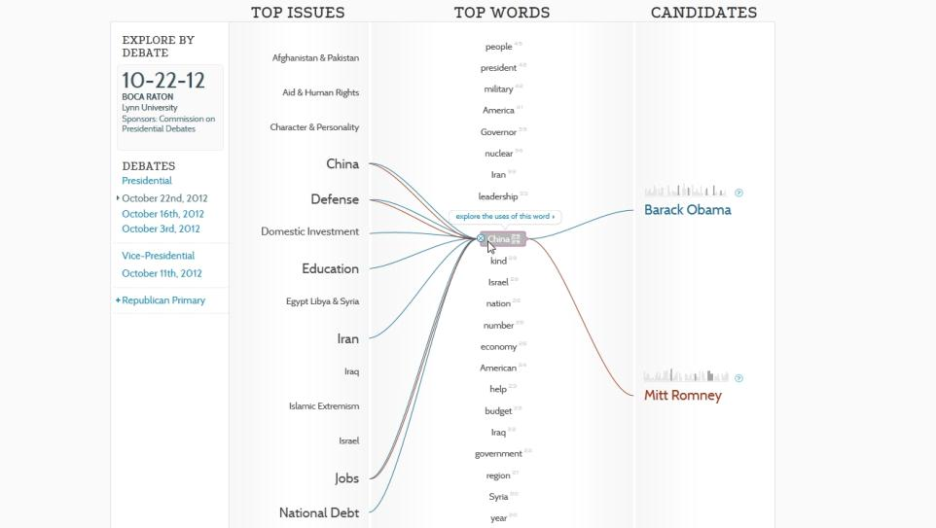
Notes:
That structure may exist in your data source already... That’s a good place to start, but don’t rely on that as the final approach. Explore some other relationships and the best way to do that is to describe those relationships in real words.

Slide 30
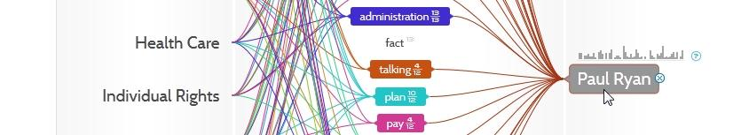
Notes:
Incidentally, here you can see the Paul Ryan didn’t say any “facts” during the VP debate. (Just kidding!)

Slide 31
Patterns
Notes:
Very similar to relationships are patterns. Sort it out. You can do this in your tools, or you can sketch or mock it up on paper.

Slide 32
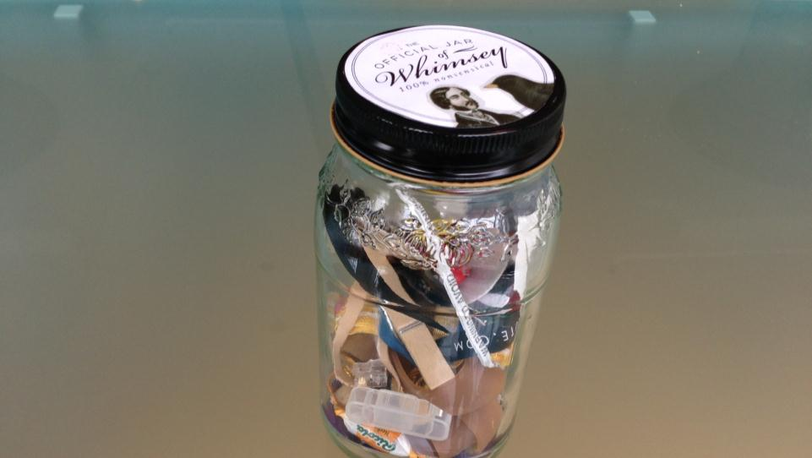
Notes:
We recently adopted the “jar of whimsy” at Periscopic. This is an exercise in finding patterns. We create a jar of random stuff – things you find in your pocket or desk drawer – then we dump out the contents and ask someone to group the pieces in ways that make sense to them.

Slide 33
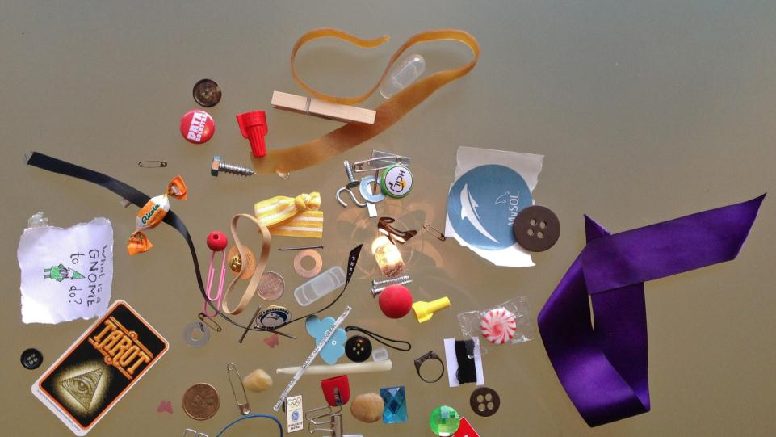
EXERCISE 3:
what are the patterns here?
Notes:
Okay, let’s look at these random, disparate items from our jar. Think about how you’d like to group them. I’ll give you a minute.
Now I can just about guarantee that everyone in the room has a different way of grouping.

Slide 34
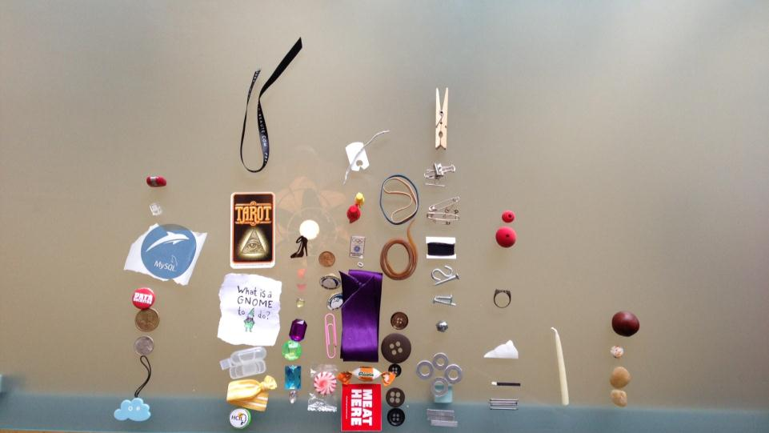
Notes:
Here’s what our Lead Programmer, Brett, came up with. He made a bar chart or histogram of sorts... The x axis is how old the item is (or could be), and the y axis is how fleeting or permanent the object is.

Slide 35
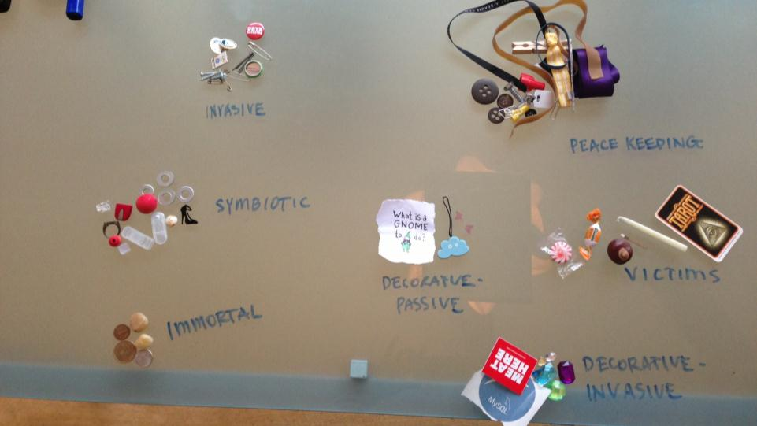
Notes:
Sam, one of our designers, sorted this way. He called it the “Personality of Objects.” So he had the “peace keeping” objects... The ones that held things together and did no harm. The “victims” or the ones that would be destroyed by their own utility. And so on.... His sorting was more qualitative, as you’d expect from a designer. Brett, the programmer, opted for something canonical... A continuum that could serve any object presented. Obviously the mind of a programmer who needs to accommodate the unexpected.

Slide 36
one
Notes:
Sometimes focusing on just one allows you to see the essential relationships. You don’t need to overwhelm the viewer with everything at once.

Slide 37
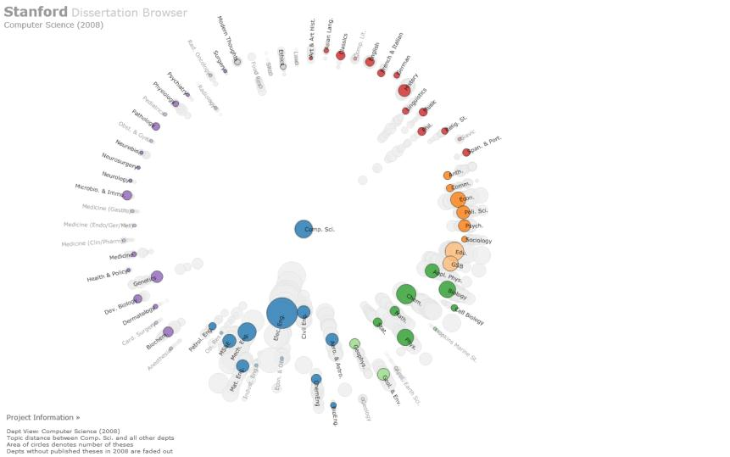
Notes:
This is Stanford’s Dissertation Browser. It’s basically a network, but THANKFULLY they didn’t draw a network diagram. Instead, you click on an area of study, such as CompSci in this example, and it shows how closely related that corpus of dissertations is to other areas. Here, you can see that compsci also gets tied in with a bunch of engineering, but also some chemistry, philosophy, etc.

Slide 38
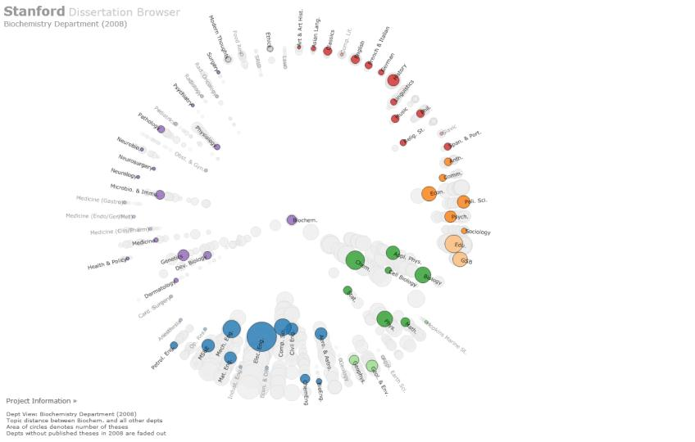
Notes:
When I click on biochemistry, I can see that it’s related to many other fields – the life sciences, but also natural sciences and engineering.
This is a great example of how interaction can allow you to focus on one thing at a time.

Slide 39
Tight Focus
Notes:
Related to the topic of “one,” if you feel like you can’t make sense of the full breadth of data in front of you, take a portion of related data and mock that up.

Slide 40
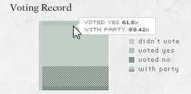
Notes:
Let’s look at this simple chart. I still don’t know what to call it. It’s something we created for a project a few years ago. It’s essentially a treemap with an overlay. It’s a little unique in that the second tier of data is related to each other. Let me show you what I mean. The first tier is how did this congress member vote on the issues: So Yes, No, or Didn’t vote. Okay, so that’s a simple treemap. But the second tier is “did they vote with their party.” Now the unique part is that you can only vote with your party if you’re voting yes or no.
So we can just butt those second tier portions up against each other, so you can easily see how much someone is voting with their party, and how they voted outside of that. So this is a unique treemap case... You can’t use it for everything.

Slide 41
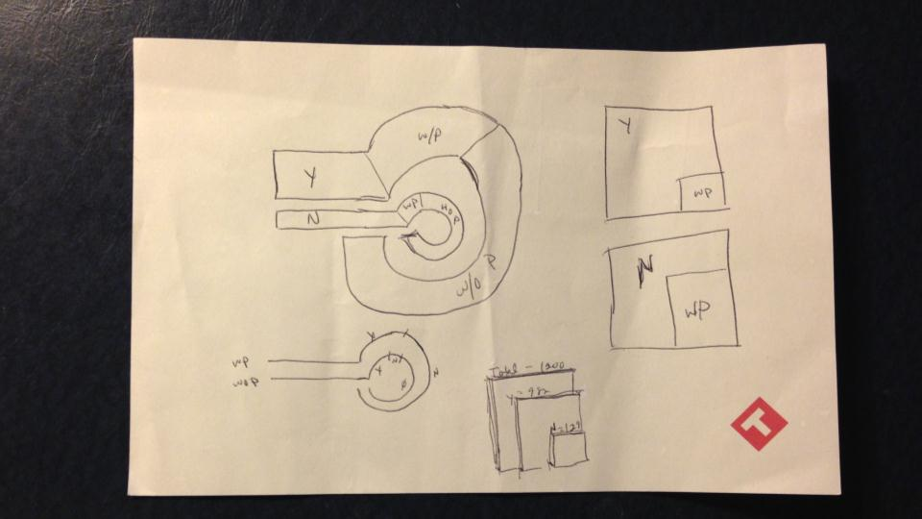
Notes:
Now that was a very tiny, basic chart, but look at all the work that went to get there. Okay, this stuff on the left.... I have no idea what’s going on there. Then at the bottom there’s a progression to something sane. Then at the right is basically where I realized there are no votes and yes votes and they have this overlap of party data.

Slide 42
Be Honest... Refine
Notes:
It’s usually never done. I still want to revisit almost every project we’ve worked on. The first solution is usually not the best one, so you need to refine. Solicit critique from others. At Periscopic, our Data Scientist, Andrew has to present his work to the team from very nascent stages and through the conversation, it helps guide the next iteration of his work.

Slide 43
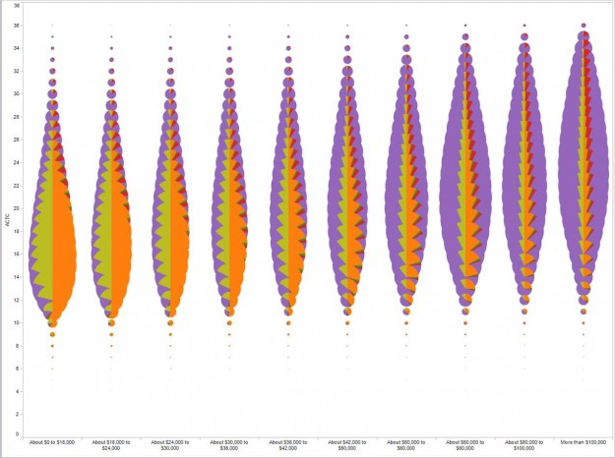
Notes:
This isn't the chart it wants to be. I’m not going to name names on this one. I found this online a few months ago. It’s beautiful in its ambition. You can see he’s using overlapping pie charts to show income related to test scores (I think... I cut off the color legend... It doesn’t really matter what it’s showing). And it looks like a compelling sketch, but then you realize that since large portions of the pie charts are occluded, so you sometimes have no way of knowing if the orange section is 25% or 65%. Make it the chart it wants to be. It clearly doesn’t work, no matter how valiant. So, refine it.
What I think happened was that he threw some data into Tableau and plotted pie charts and it spit out this, and thinking “well, this looks like nothing before it,” he fell in love with it. Sometimes you fall in love with ridiculous things. Seek validation from others.

Slide 44
Get Real
Notes:
Don’t be afraid to get literal. I normally hate going down that path, but sometimes it makes the most sense.

Slide 45
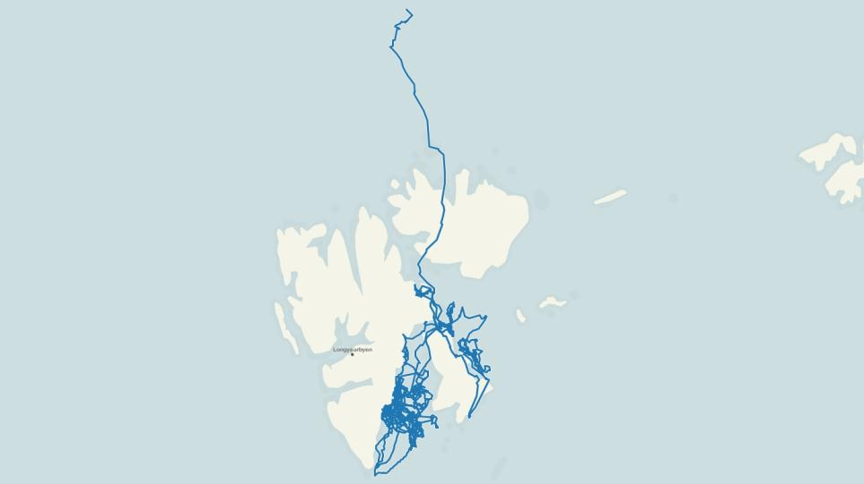
Notes:
Ok, again with the polar bears! We got some polar bear GPS data for our project. This is data over the course of 2 years. So here I dump it into Tableau and get this literal spatial representation.

Slide 46
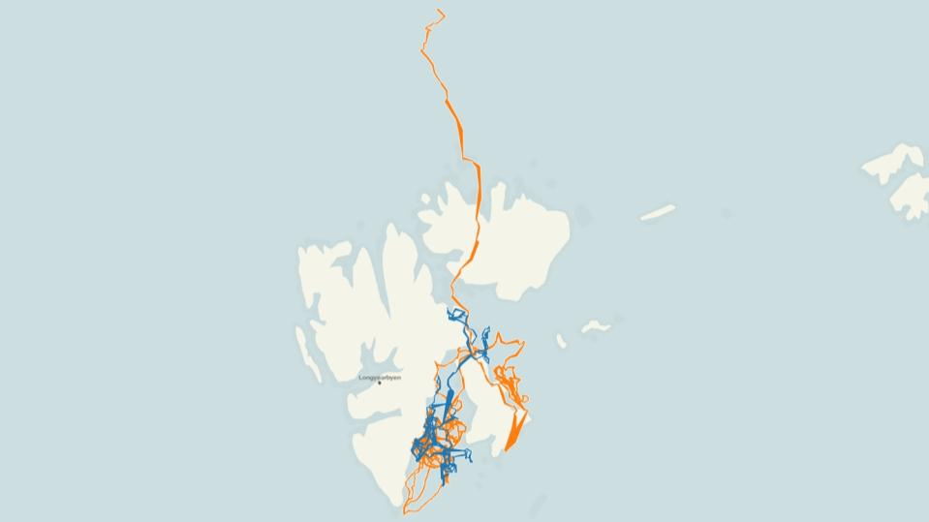
Notes:
But of course we can add to that view to add some intelligence. Here the color represents the different years. So you can see in 2000, the bears didn’t venture very far, but they really went nuts in 2001.

Slide 47
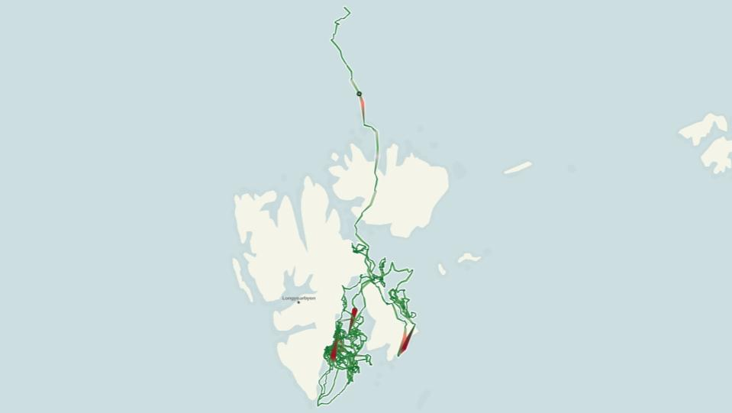
Notes:
Going a step further and getting more into the mindset and the life of the bear, we color coded by how far the bear travelled each day. So the more ground they covered, they went into the red zone. Now this could be used to show how bears really have to chase the ice in order to eat.

Slide 48
Everyone Needs a Hand to Hold onto
Notes:
Close to literal, but not quite is the concept of a metaphor. People like to have familiar things to steady themselves, or situate themselves. That’s why metaphor can be so powerful for data viz.

Slide 49
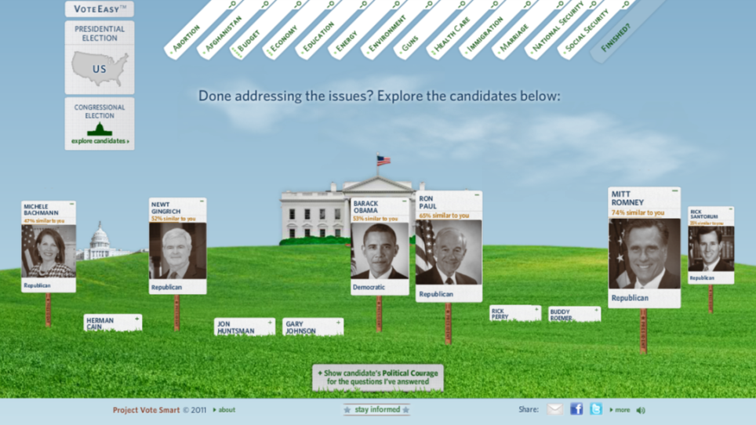
Notes:
This is a project we did called VoteEasy, it’s like Match.com for political candidates. It uses the metaphor of political yard signs to signify someone’s similarity to you. To find a metaphor, think about what your data is actually enabling in the real world. A good way to get into this is to watch Hans Rosling talks. He’s the king of metaphor and data storytelling.

Slide 50
Final Tips
Notes:
Okay, there’s so much more. This is just a high level look. Some quick notes to finish off.

Slide 51
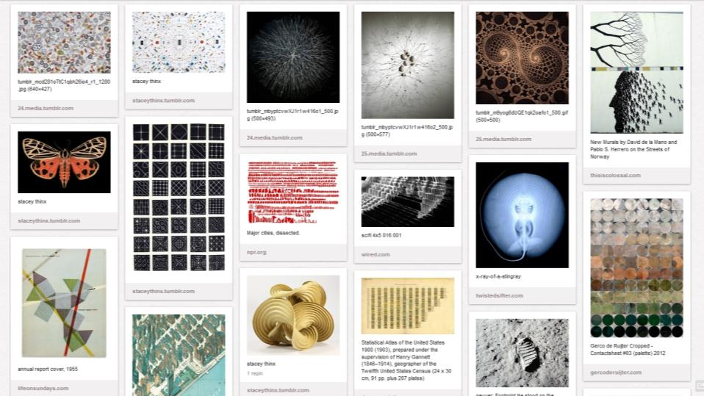
Notes:
Keep a file of inspiration. Now this can be anything from other data visualizations, or just patterns you see in the wild, artwork, color schemes, and so on.
At Periscopic we keep a few Pinterest boards to capture these things. This is incredibly useful when you feel stuck.
http://pinterest.com/Periscopic/

Slide 52
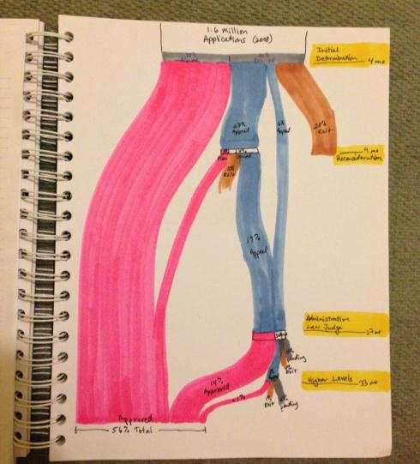
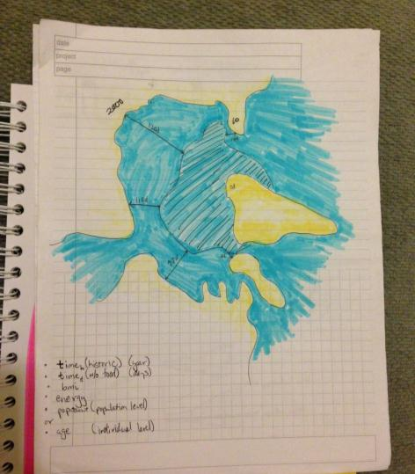
Notes:
Keep a sketchbook. Even if you hate to draw. You don’t have to show anybody. Use a good quality paper and high quality pens, markers or whatever you choose.

Slide 53
How to See Data
Kim Rees, Periscopic
@periscopic, @krees
Notes:
Thanks. Please hit me up on twitter if you want to chat further.
By the way, for all of you who downloaded this and made it this far, you get the bonus of finding out that this is my 5 year old, the one I reference in the “kids dying” chart. You can see he’s alive, healthy, and loves dataviz! ☺
Actually, if you made it this far, tweet or email me the phrase “I see data” and I’ll send you a special something.
@krees on Twitter or kim@periscopic.com

